Slide 1

Factors of production activity
1.1.1 The economic problem

Slide 2
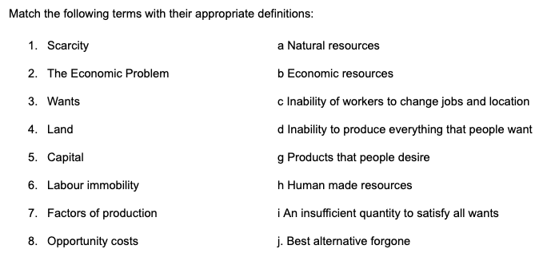
Match the key term
Notes:
https://docs.google.com/document/d/1f6GqjPT68kCtaDcRDljuPuDt9Hkx5gg9Q3H0pHLgIA8/edit

Slide 3
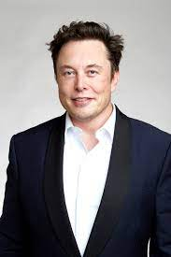

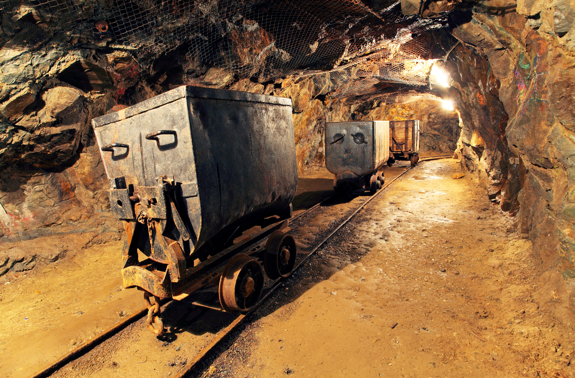
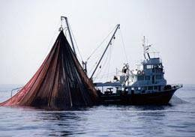
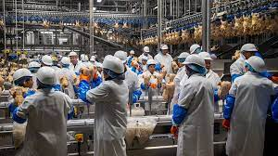
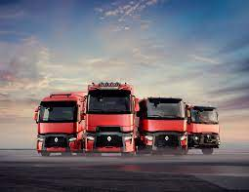
Identify the factor of production

Slide 4
Task
Select a business/company and create infographics where you:
Select a business of interest
Define the 4 factors of production (land, labour, capital and enterprise).
Give examples of each factor of production within the selected business.
Define and give examples of ‘scarcity’ and ‘opportunity’ cost - also applied to the business.
Define the ‘economic problem’. How is this business answering the 3 economic questions?
Upload to evidencer under ‘Factors of production info graph’.

Slide 5
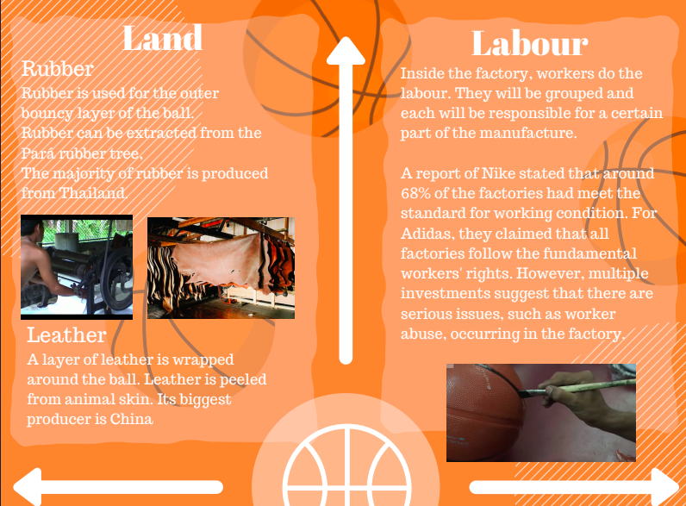
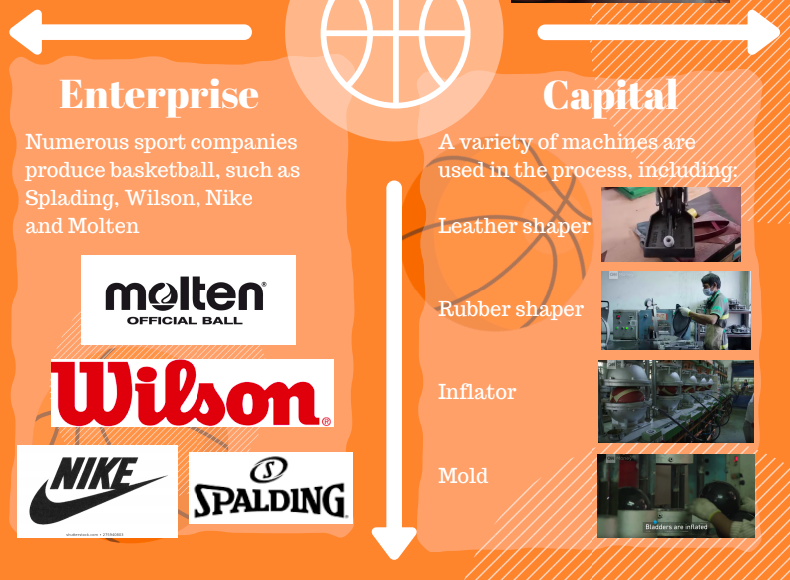
Student examples

Slide 6
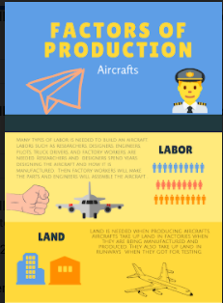
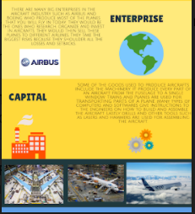
Student examples

Slide 7
..if you finish
Make sure all key terms and definitions are in your notes.
Try to discuss and complete the case study on the next slide.

Slide 8
